Slide 1
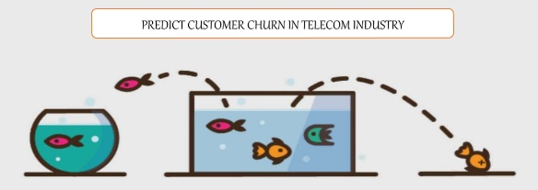
Bhargava Gaggainpali
Final_Project-DSC630_Predective_Analytics

Slide 2
Introduction:
Customer churn is a major problem and one of the most important concerns for every company. Retaining an existing customer is many times more effective thanks gaining new customers. Generally, people only switch to a different company only when the service is not to the level of expectation in one or the other factor when compared to competitors, more than getting attracted to the specials and offers which are offered by the other companies. As the number of peoples who use a phone or a telecom product does not increase in huge volume, any company looking to improve the profits is trying to attract other company customers. At the same time retaining existing customers is very important. As retaining a current customer is ten times more productive than gaining a new one.

Slide 3
Problem Statement:
As customer churn directly effects the revenues of the companies, companies are seeking to develop means to predict potential customer to churn. Therefore, finding factors that increase customer churn is important to take necessary actions to reduce this churn and retain the customers.
Scope:
Scope of the project is to use the sample dataset from Kaggle, which shows several categories of customers and also some influencing factors causing the customer churn in the telecom industry to perform customer segmentation and identify a pattern which influence the customer churn. Implement supervised machine learning process to achieve the goal.

Slide 4
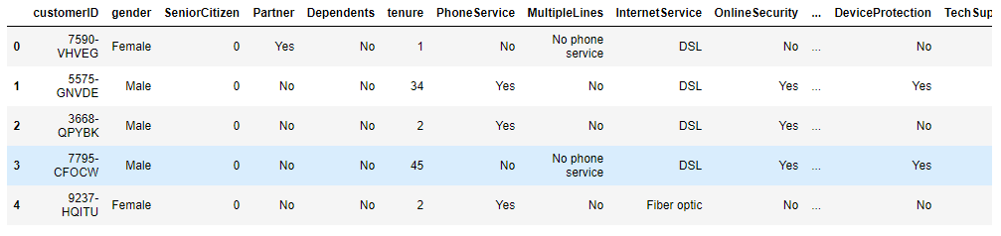
Data source:
Data source from Kaggle. 7043 observations and 21 variables
Link : Telco Customer Churn | Kaggle
customerID
gender
SeniorCitizen
Partner
Dependents
tenure
PhoneService
MultipleLines
InternetService
OnlineSecurity
OnlineBackup
DeviceProtectio
TechSupport
StreamingTV
15. StreamingMovies
16. Contract
17. PaperlessBilling
18. PaymentMethod
19. MonthlyCharges
20. TotalCharges
21. Churn

Slide 5
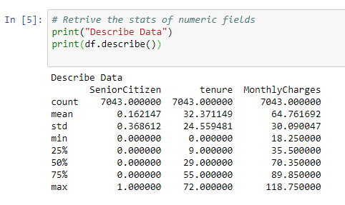
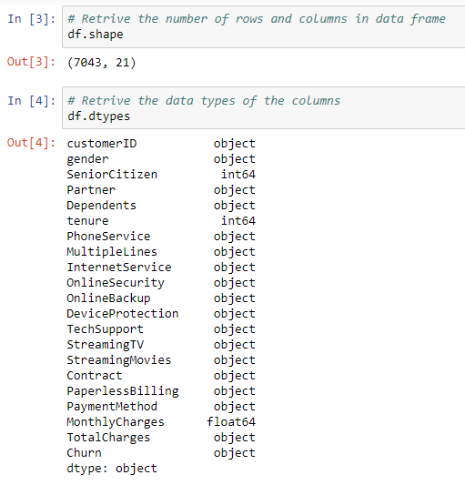
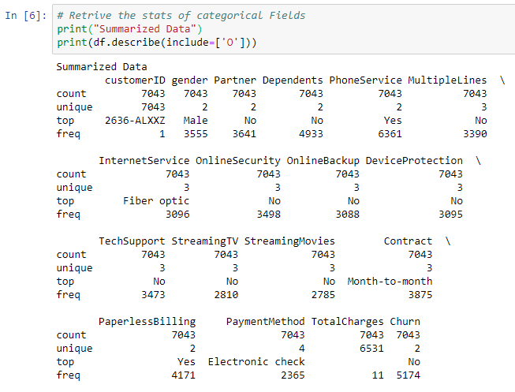
Collect basic stats of the dataset:
Observation is that, only 3 variables are numeric and rest all are categorical values.

Slide 6
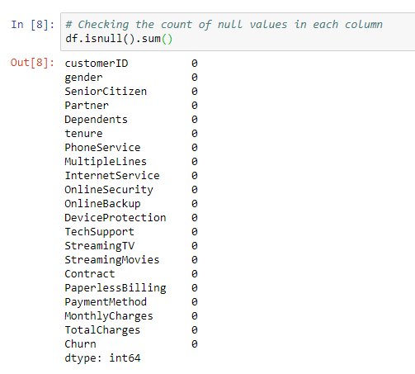
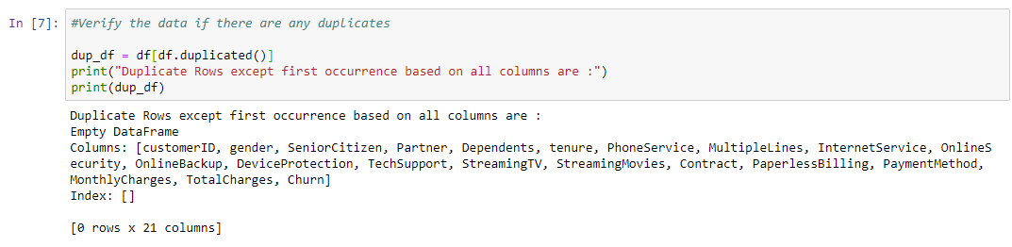
Perform exploratory data analysis on the dataset:
Observation is that, there is no null values in any of the columns and when checked for duplicate rows, we found not duplicate observations.

Slide 7
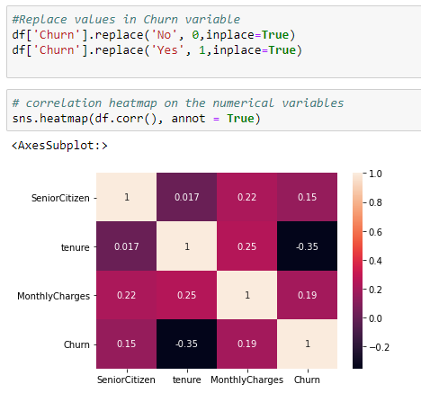
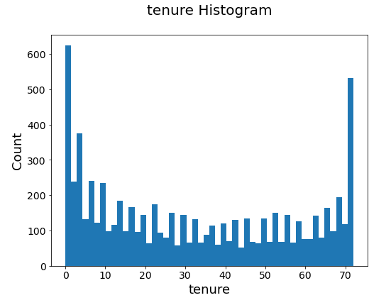
Analyze Numerical variables in the dataset:
Observation is that, “tenure” variable has a better correlation with comparison to the output variable “churn”.
We built a histogram to see the spread of the data.

Slide 8
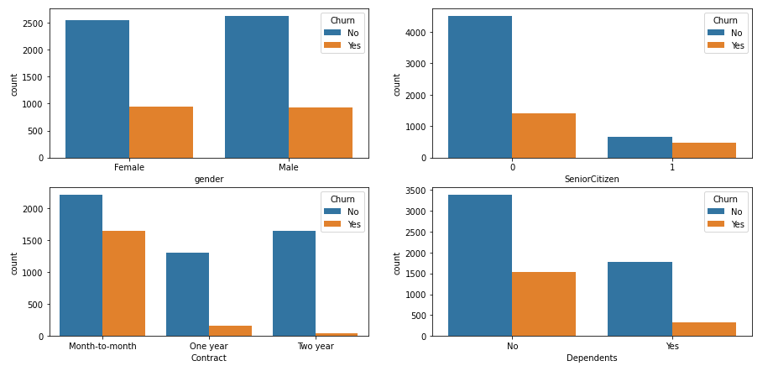
Analyze Categorical variables in the dataset:
Variable “gender” has both Male and Female members and has equal customer churn.
For “Senior Citizen”, we see that churn is more when the customer is not Senior Citizen.
Churn is more when the “Contract” is ‘month-to-month’.
Churn is more when customers has no “Dependents” .

Slide 9
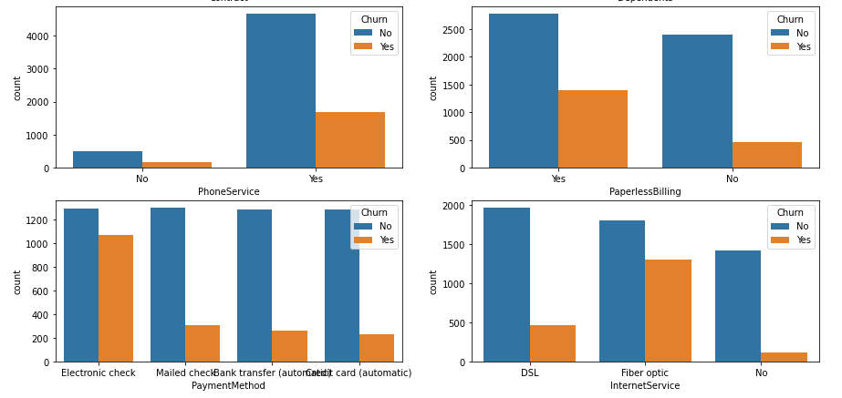
Analyze Categorical variables in the dataset:
Customers having “Phone Service” has higher Customer churn.
Customers who opted for “Paperless Billing” has higher Customer churn.
Customers who generally pay with ‘Electronic Check’ has higher Customer churn.
Customers who are using ‘Fiber Optic’ as “Internet Service” has higher Customer churn.

Slide 10
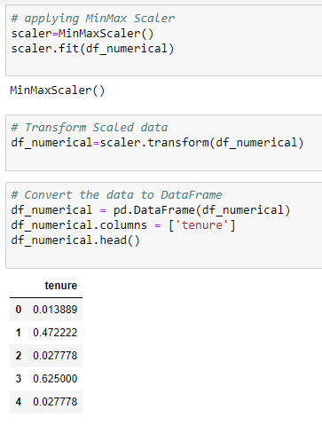
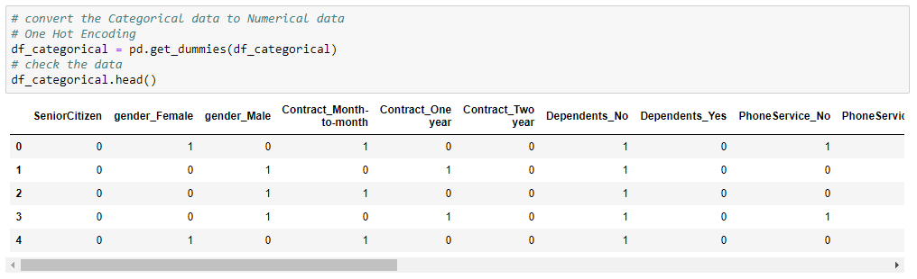
Applying Encoding methods:
Applied Encoding method to convert Categorical variables to numerical values.
Applied Scalar method to convert the Numerical variable to reduce the value and maintain consistent value range.

Slide 11
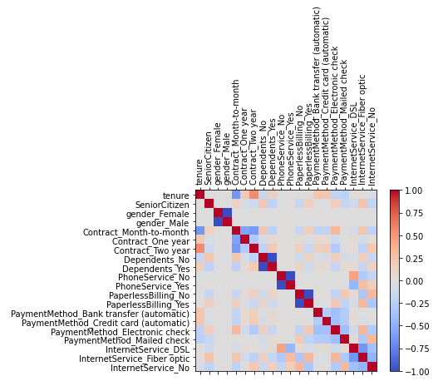
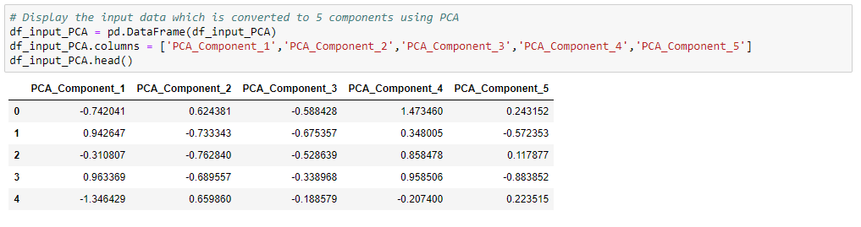
Applied Dimension reduction method :
After converting categorical variables to numeric values, the number of input variables have increased.
Applied PCA method to reduce the number of variables to 5.

Slide 12
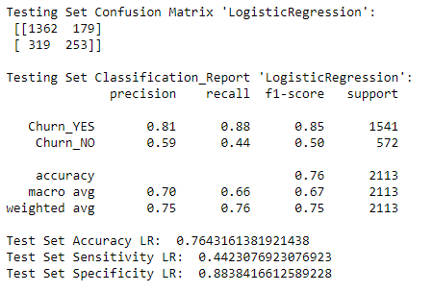
Applied ML model
Logistic Regression:
Applied Machine Learning model, “Logistic Regression” on the training data set and evaluated the performance of the model using test set.
Accuracy is observed to be as 76%.

Slide 13
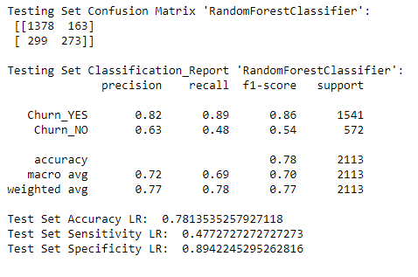
Applied ML model
Random Forest Classifier:
Applied Machine Learning model, “Random Forest Classifier” on the training data set and evaluated the performance of the model using test set.
Accuracy is observed to be as 78%.

Slide 14
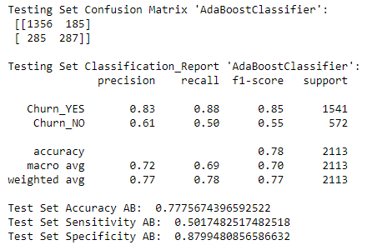
Applied ML model
Ada Boost Classifier:
Applied Machine Learning model, “Ada Boost Classifier” on the training data set and evaluated the performance of the model using test set.
Accuracy is observed to be as 77%.

Slide 15
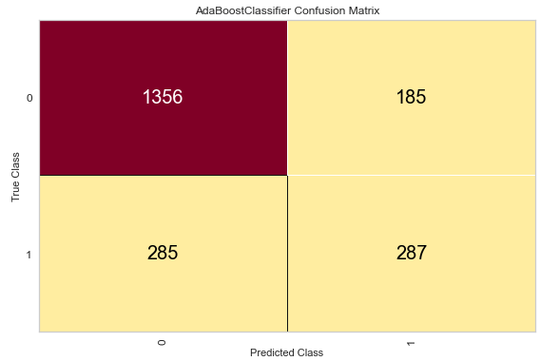
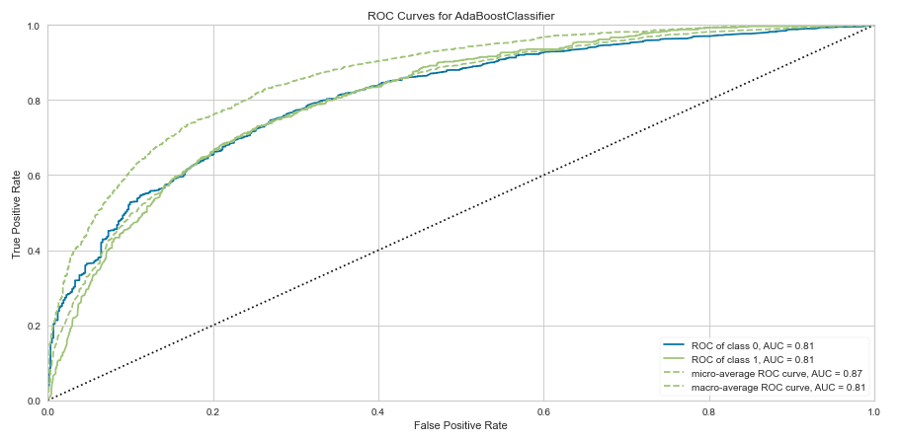
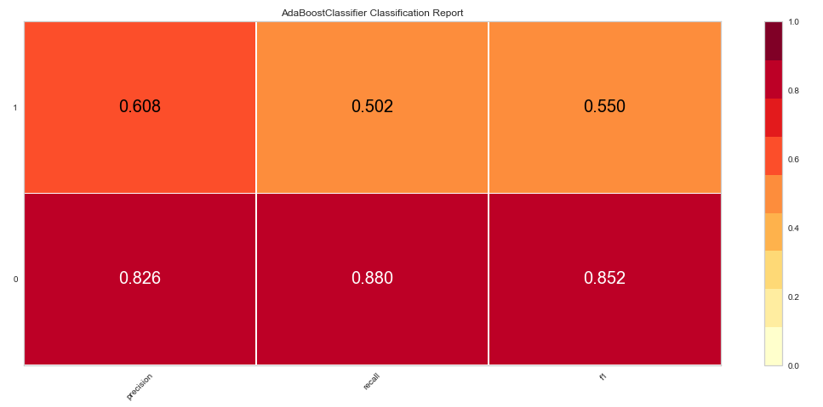
Evaluate the results:
Using Confusion matrix, evaluated the results and calculated ‘Precision , Recall and f1 score.
Built ROC curve and observed the AUC (area under curve) values as 0.81 .

Slide 16
Reference:
Reference:
1. “’Predictive Analytics’ The power to predict who will click, buy, lie or die” by Eric Siegel.
2. “‘Applied Predictive Analytics’ Principles and techniques for the professional data analyst” by Dean Abbot.
3. https://www.kaggle.com/blastchar/telco-customer-churn
How Costly Is Customer Churn in the Telecom Industry? - The European Business Review
https://www.europeanbusinessreview.com/how-costly-is-customer-churn-in-the-telecom-industry/?__cf_chl_jschl_tk__=ec58e0210ef4250a8414742b7aaa8d8e28384753-1611086044-0-AXu6Mldw8Cpmi6L6s5SgV1PXJkIGPIbNtM2k3mk8dG4GwrfiMZ4fT3rVf0CPVbws4ipH6NuFN2fITmeBiQb8uSJYkXQKBcXB-e3XBH6IJWYli7zOM4eqnO9BCh0JE11v9IHHQZeKKMNRTUecYHq5Mahj6uNBBJ23n_LWFAdEF677ZQEQpPYruho0OLOLbdjBj-oKjPGHAZ52v2QMgPAHjyXRIDb-FEUu_sFhz8CW6q0KxFhOgoPWW_R8KZhMo4AOUlv2fbzwIi3oYhYXMSMOdAjpE9u7gRwD-0RQeFCEtTEzQqRmjC2QEbIGAHZKgbkn99TTuu5kBJLOuOoRLFhaD9d-oHKuQ27yx7WrU_mDPxYdp7qkByeE3o25LzRg460JyA

